Slide 1
Fence Patrol
Python with Robots Mission 5
Lesson 3 Objectives 6-8

Slide 2

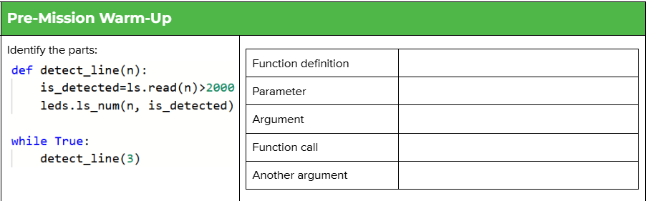
Pre-Mission Warm-Up
In your Mission 5 Lesson 3 log, complete the chart in the pre-mission warm-up:

Slide 3
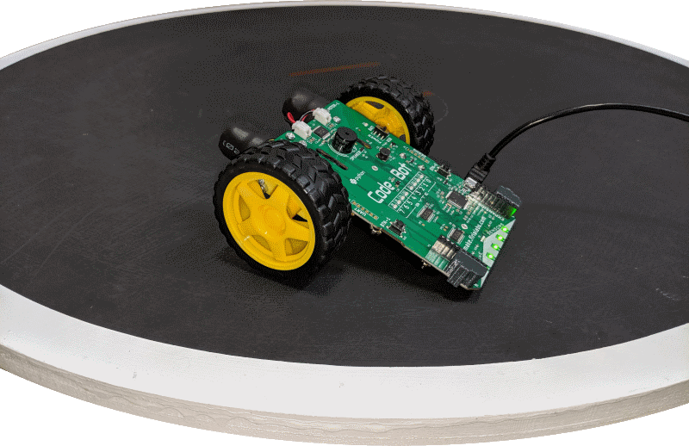
Mission 5: Fence Patrol
In this project, you will learn how to use data from CodeBot’s line sensors.
CodeBot has five line sensors mounted on the front of its board.
The sensors allow CodeBot to interact with its environment.

Slide 4
Mission 5: Fence Patrol
Project goals:
Read the line sensor and display the results on the green LEDs above them.
Use analog readings to measure the contrast between different surfaces.
Make a contact counter to show each line detect on the red User LEDs.
Teach CodeBot to drive between the lines!

Slide 5
Mission 5: Fence Patrol
For this lesson, we will complete the third task:
Make a contact counter to show each line detect on the red User LEDs.

Slide 6

Objective #6: Defensive Driving
Your sensors are tuned up and ready!
Soon you will add motors into the fun.
But before your ‘bot gets moving, we need to think about safety!

Slide 7

Objective #6: Defensive Driving
Open your LineSense program.
Open your program from
Mission 4 Lesson 3 RobotMoves

Slide 8
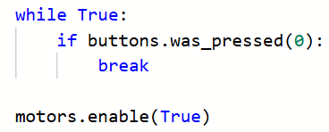
Objective #6: Defensive Driving
Look for this code segment in the program:
What does it do?

Slide 9
Objective #6 Activity
DO THIS:
Copy that code segment from RobotMoves and paste it into LineSense, just above the main program’s while loop.

Slide 10
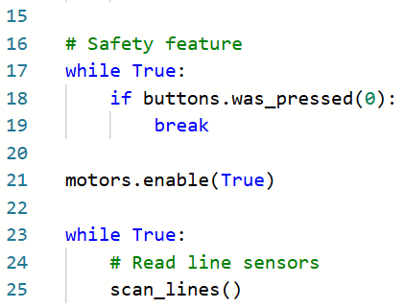
Objective #6 Activity
DO THIS:

Slide 11
Objective #6 Activity
DO THIS:
Run your program.
Place the ‘bot on the white rectangle from the Test Surface paper.
Put a small black paper under a line sensor.
Then press BTN-0.
No LEDs should turn on/off until BTN-0 is pressed – safety!!

Slide 12
Objective #7 (Part 1): Driving in Bounds
Before the ‘bot moves, we will improve the functions we already have to make them more efficient.
You need to make a small change to the detect_line() function.
Right now, it turns on/off the LED above the line sensor.
You need it to also tell the function call if the is_detect is True or False.
The function can return this information.

Slide 13
Objective #7 (Part 1): Driving in Bounds
Concept: Function Return
A function can be a two-way street!
You can pass arguments IN to a function. The values go to parameters.
When a function finishes, it can return things OUT, back to the code that called it.

Slide 14
Objective #7 (Part 1): Driving in Bounds
Concept: Function Return
A function can use the return statement to send a value back to the function call.
The return statement ends the function.
The return value is substituted for the function call.

Slide 15
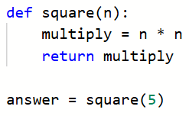
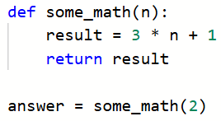
Objective #7 (Part 1): Driving in Bounds
Concept: Function Return
Example: Example:
answer = 25 answer = 7

Slide 16
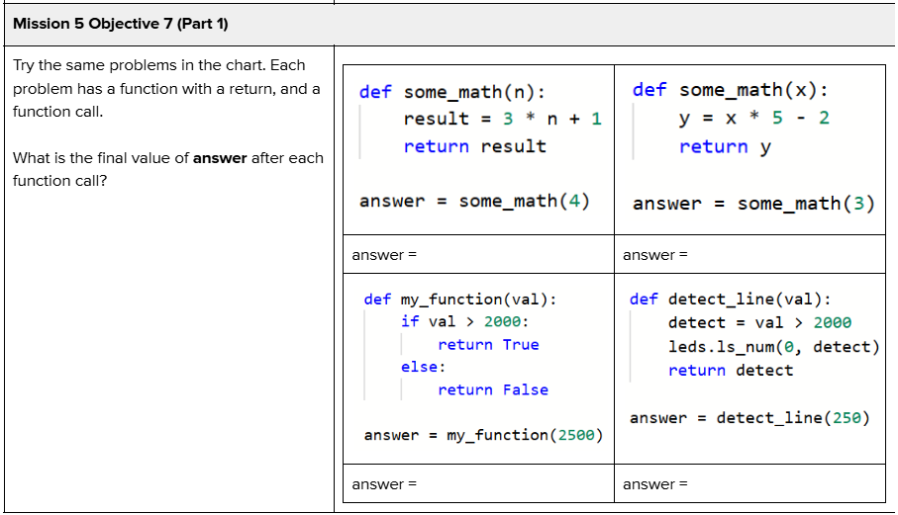
Objective #7 (Part 1) Activity
DO THIS:
Try the sample problems on your mission log.

Slide 17
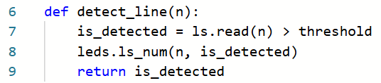
Objective #7 (Part 1) Activity
DO THIS:
Return to your file – LineSense
Modify the detect_line() function by adding a return statement.

Slide 18
Objective #7 (Part 1): Driving in Bounds
The function scan_lines() calls detect_line(), so it will need to use the information returned by detect_line().
Define a Boolean variable in scan_lines().
It’s initial value will be False (no line detected)
Use the return value of detect_line() to update the new Boolean variable.

Slide 19
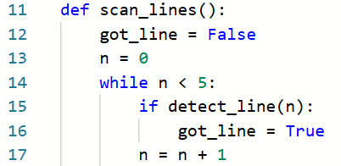
Objective #7 (Part 1) Activity
DO THIS:
Modify the scan_lines() function:
Function call

Slide 20
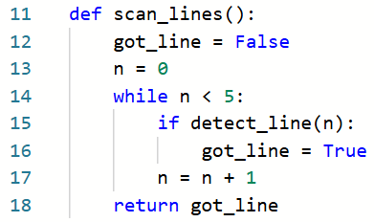
Objective #7 (Part 1) Activity
DO THIS:
The scan_lines() function will also return a value:

Slide 21
Objective #7 (Part 2): Driving in Bounds
Now we will complete the goal for this lesson:
Make a contact counter to show each line detect on the red User LEDs.
The contact counter will count each time a line is detected.
You will need another variable that will be incremented.
Use the variable to display the count using the red user LEDs.
The count will be converted to binary, and then displayed by turning on/off the LEDs.
You did something similar to this during Mission 3 Lesson 2. But you don’t have to do the conversion; the computer will do that for you!

Slide 22
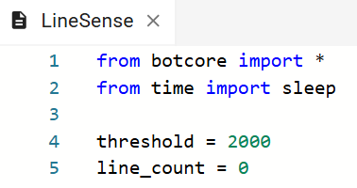
Objective #7 (Part 2) Activity
DO THIS:
Add a new variable for counting:

Slide 23
Objective #7 (Part 2) Activity
DO THIS:
Modify the main program’s while loop:
Since scan_lines() returns a value, it needs to be used in the function call.
Assign the return value to a new variable, which
will count line detections.
Add an if statement to increment the new variable and use it to display the count using red user LEDs.

Slide 24
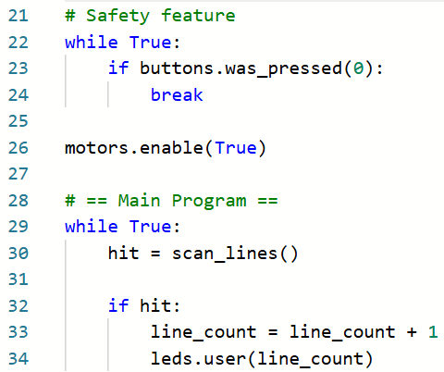
Objective #7 (Part 2) Activity
DO THIS:

Slide 25
Objective #7 (Part 2) Activity
DO THIS:
Run your program.
Place the ‘bot on the white rectangle from the Test Surface paper.
Put a small black paper under a line sensor.
Then press BTN-0.
Move the paper under the line sensors and watch the user LEDs display the count in binary.
Can you get all the user LEDs turned on?
What happens with the next count after that?

Slide 26
Objective #8: Flicker Begone!
Is it just me, or are your user LEDs flickering like crazy?
They are actually counting up in binary.
After the count reaches 0b11111111, or 255, … BOOM!
255 is the highest number that can be displayed using 8 LEDs.
When a program stops while it is running, it is called a runtime error.
Let’s add an if statement to reset line_count when it reaches 256.

Slide 27


Objective #8: Flicker Begone!
You did something like this in Mission 4 Lesson 1 SweepLEDs
For this program, the max number is 256 and the variable is line_count

Slide 28
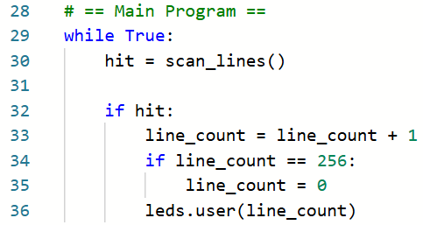
Objective #8 Activity
DO THIS:
Add the if statement to the main program loop

Slide 29
Objective #8 Activity
DO THIS:
Run your program.
Place the ‘bot on the white rectangle from the Test Surface paper.
Put a small black paper under a line sensor.
Then press BTN-0.
Move the paper under the line sensors and watch the user LEDs display the count in binary.
The program should run error-free.

Slide 30

Extension
Here is an additional challenge:
Play a tone when the counter variable is incremented.

Slide 31
Post-Mission Reflection
Complete the post-mission reflection in your Mission 5 Lesson 3 Log:
How does a function send back a value to the function call?
Give an example of calling function that has a return.

